Slide 1
Indigenous Focus at CSMLS
Creating Cultural Awareness and Inclusion Opportunities

Slide 2
Land Recognition
We are on the traditional territories of:
the Mississauga and Haudenosaunee nations,
within the lands protected by the Dish With One Spoon wampum agreement.

Slide 3
Questions to be answered
Where did the project come from?
Why did CSMLS take a different approach to project design?
We are non-experts delving into a sensitive and highly political topic.
How have you contributed to making CSMLS and its members more culturally aware and inclusive?
What’s planned next?

Slide 4
Research & Special Initiatives Department
Research
Special
Initiatives
Member Benefits
Organization Support

Slide 5
The transmission of knowledge and conduct of scholarly inquiry are central and complementary functions at CSMLS
Research will focus on trending information: health and education systems, humans and policy from the medical laboratory science perspective
Research will not focus on animals, biologicals or non-trending information unless the rationale is validated
Research will be driven by member, profession and CSMLS information needs; Partnership are imperative for growth

Slide 6
The transmission of knowledge and conduct of scholarly inquiry are central and complementary functions at CSMLS
Projects identify non-scientific and scientific areas that require focused attention;
Projects are facilitated by and managed with multiple organizations/stakeholders through pan-national focused activities
Projects are not provincial/territory specific unless rationale is validated
Projects include advocacy, culture change initiatives and perspective gathering (quality assurance)

Slide 7
Strategy 3: “Sucking Black Hole”
Advocate for solutions within the health care system
on behalf of the medical laboratory profession.
Laura’s Desk
Truth: Health system projects effect more than Strategy 3.

Slide 8
Which health system idea does one pick?
Cyto
Techs
Mental Health
Ethics
HHR Shortage
So what health system topics were important?
Oversupply
of MLAs
(precarious jobs)
Lab Test Utilization
Truth and Reconciliation Report (TRC)
Cannabis Legalization
Yes, researchers are this happy when brain storming ideas!

Slide 9
TRC in Canada
2007 - Indian Residential Schools Settlement Agreement
Establishment of the Truth and Reconciliation Commission of Canada (TRC) to facilitate reconciliation among former students, their families, their communities and all Canadians.
Prime Minister Justin Trudeau accepted the Final Report of the TRC on behalf of Canada. The Government of Canada continues to be committed to a renewed nation-to-nation relationship with Indigenous peoples based on recognition of rights, respect, co-operation and partnership.
7 health related recommendations
Three years since the original report release, health profession associations have begun to release relevant policies to support this cause.

Slide 10
How does CSMLS get started?
What level of knowledge do we have?
Do we have to? Do we want to?
Is this a token project? What is driving the project?
Is it too political?
Do we spend members $$ on it?
Will members and staff care?
What is an Indigenous focused project?
How do we approach it?

Slide 11
Information Gathering
Personal: Experience of others and ourselves (always)
Education: Course & Information Gathering (2016/17)
Membership: Call out for information (2017)
National: Government (TRC, 2015)
CJMLS Article 1: Education Experience (2017)
CJMLS Article 2: Member’s Experience (2018)
Recognition more could be done…..
Backgrounder created for LT (2016)
Notes:
The Research & Special Initiatives Department aims to meet member needs by :
1. Creating and identifying previously unknown information
2. Produce products and services to meet information needs
3. Transfer beneficial information to members, stakeholders and the public

Slide 12
Natural vs Abrupt Evolution
Information gathering and story telling
generalized discussions with Indigenous organizations, independent discussions with CSMLS members, Content Advisory Committee, CSMLS staff and Board of Directors.
As we learned, we designed and implemented.
No concrete plan to begin; Fluid design with small incremental changes.
Consistently a bottom-up approach
Everyone’s responsibility

Slide 13
Guiding Principles Developed
Recognition: different levels of knowledge & awareness
Acceptance: we have a journey of learning & growing
Diversity: Indigenous culture is not one concept
Evidence-based facts presented under a solution seeking and forward-thinking lens
Expertise and consultation are integral
Tokenism should not occur
Language is important

Slide 14
Purpose
Part 1: To provide a sustainable project that focuses on Indigenous culture awareness through products, resources and services by CSMLS to its members.
All components of the project are in
alignment with, embody the philosophy
within the call to actions put forth in the TRC.

Slide 15
Resources & Services
Mental Health Toolkit
Curated Content Webpage
Products
Other Communication Products
Podcast - Northern Health: Obstacles and Understanding (episode 18; 2018)
Ethics on Demand
Events
LABCON
Ceremonial service such as a blessing or drumming session*
CSMLS Staff Presentations
Aboriginal Language Grant (submitted 2019)
CAMRT TB project (submitted 2019)
Position Statement
Indigenous-Focused Webpage
Pre-planned promotion of cultural sensitivity training, online courses available and CSMLS related products / activities (across 2 years)
Create an Indigenous mental health dedicated webpage
Collaboration with Queen's University and CSMLS Research
Launch Oct 2019
Provide links to pre-existing Indigenous information, resources and organizations
CSMLS produced two perspective articles (Zychla; 2017-18)
Flag Loan for Treaty Days
President's Letter (2019)
Karen Lawford (Queen's University partner)
CSMLS flag provided to member for event (2018)
Advertise opportunity to membership (x2, 2019-20)
LabBuzz - Inclusion of Indigenous content when identified (ongoing); does not have to be MLP specific, but must be health-related.
CJMLS
Indigenous racism article (2019)
Research Ethics Board
Ensure training includes TCPS 2 (2014) components focused on research Involving First Nations, Inuit and Métis Peoples of Canada (2018) - Module 9
Launch Jun 2019
Expert presenter requests
Land acknowledgements, voluntary and standardized statements reflective of the location the presentation will occur (2019)
Projects &
Policy
Land Recognition
Call to Action
Incorporates inclusion opportunities for Indigenous students (2018)
Commitment to carry process forward into future LABCONs for 2 years minimum*,
Board of Directors and Leadership Team
Participation in KAIROS Blanket Ceremony (2018)
Knowledge and content discussions during meetings (ongoing)
CEO education (online courses and event; recommendations provided to all staff; ongoing)
All Staff
Procured Indigenous Atlas Book (2019)
Curated Indigenous information links in an email series from HR (ongoing)
Content Advisory Committee
MLP stakeholders who can provide insight on content considerations (ongoing)
Research
In support of Indigenous inclusion and recognition of policies documents such as the TRC (2019).
Validation process to ensure that content, language and intent are clear and appropriate (webinar or F2F meeting in Hamilton with targeted stakeholders; 2020)
Promotion of open discussions about Indigenous knowledge and information needs (ongoing)
Social Media
Under the Special Projects section of CSMLS website, identify all of the project plan components to showcase CSMLS support (2019)
Submit for a CSAE award associated with the Indigenous Project (2019)
Publish at least one relevant article annually for next 3 years
Advertise cultural sensitivity training and related CSMLS products (2 years)
Inclusion of relevant news articles that support advocacy (ongoing)
CSMLS
Knowledge
Produce a land recognition and dedication service for the CSMLS building to celebrate the territory (2019-20)
Provide an overview to staff of the project plan in a Lunch and Learning setting (June 2019)
New projects considered case by case
Land acknowledgements
(*where funds allow)
Staff education piece required
CSMLS has done a lot of work already.
I couldn’t even fit the table on this slide.
Go big or go home!

Slide 16
Project Outline
What have you contributed to?

Slide 17
Resources and Services
Mental Health Toolkit
Created an Indigenous mental health dedicated webpage
Collaboration with Queen's University and CSMLS Research
Launch Oct 2019
Curated Content Webpage
Provide links to pre-existing Indigenous information, resources and organizations
Launch Jun 2019
Flag Loan for Treaty Days
CSMLS flag provided to member for event (2018)
Research Ethics Board
Ensure training includes TCPS 2 (2014) components focused on research Involving First Nations, Inuit and Métis Peoples of Canada (2018) - Module 9

Slide 18
Products
Journal
CSMLS produced two perspective articles (2017-18)
President's Letter (2019)
Ethics
Ethics on Demand: Indigenous racism article (2019)
Ethics flash card game (2019)
Call to Action
Inclusion language (2018)
Other Communication Products
LabBuzz - Inclusion of Indigenous content when identified (ongoing); does not have to be MLP specific, but must be health-related.
Podcast - Northern Health: Obstacles and Understanding (episode 18; 2018)

Slide 19
Events
LABCON 2019
Ceremonial service (knowledge keeper)
Land acknowledgement
CSMLS Staff Presentations (live events)
Land acknowledgements, voluntary (ongoing)

Slide 20
Projects & Policy
Research
New projects considered case by case
Aboriginal Language Grant (submitted 2019)
Joint TB project - CAMRT (ITK)
Position Statement
In support of Indigenous inclusion and recognition of policies documents such as the TRC (2019)
Validation process to ensure that content, language and intent are clear and appropriate (webinar or F2F meeting in Hamilton with targeted stakeholders; 2020)
Land Recognition
Produce a land recognition and dedication for the CSMLS building to celebrate the territory (2019-2020)

Slide 21
CSMLS Knowledge
Board of Directors and Leadership Team
KAIROS Blanket Ceremony (2018)
Knowledge and content discussions during meetings
CEO education (3 online courses and event; recommendations provided to all staff; ongoing)
All Staff
Procured Indigenous Atlas Book (2019)
Curated Indigenous information links from HR (2018)
Promotion of open discussions about Indigenous knowledge and information needs (ongoing)
Content Advisory Committee
MLP stakeholders who can provide insight on content considerations (2019)

Slide 22
Back to the future….
Disclaimer:
Duties have NOT been assigned. Don’t panic!

Slide 23
Purpose
Part 2: Within two years, members should use the CSMLS provided and curated content within their practice and for continuing professional education purposes.
All components of the project are in
alignment with, embody the philosophy
within the call to actions put forth in the TRC.

Slide 24
The Future
Resources and Services
CSMLS Flag Loan for Treaty Days
Advertise opportunity to membership (x2, 2019-20)
Events
LABCON
Commitment to carry process forward into future LABCONs for 2 years minimum (where funds allow)
CSMLS Staff Presentations
Land acknowledgements, voluntary and standardized statements reflective of the location the presentation will occur (2019)
Staff education piece

Slide 25
The Future
Projects and Policy
Indigenous-Focused Webpage
Under the Special Projects section of CSMLS website, identify all of the project plan components to showcase CSMLS support (2019/20)
Social Media
Pre-planned promotion of cultural sensitivity training, online courses available and CSMLS related products / activities (across 2 years)
Inclusion of relevant news articles that support advocacy (ongoing)

Slide 26
The Future
Products
Journal
Publish at least one relevant article annually for next 3 years
Karen Lawford (Queen's University partner)
Advertise cultural sensitivity training and related CSMLS products (2 years)

Slide 27
Inspired to learn more?
CSMLS Indigenous Health Resource Page

Slide 28
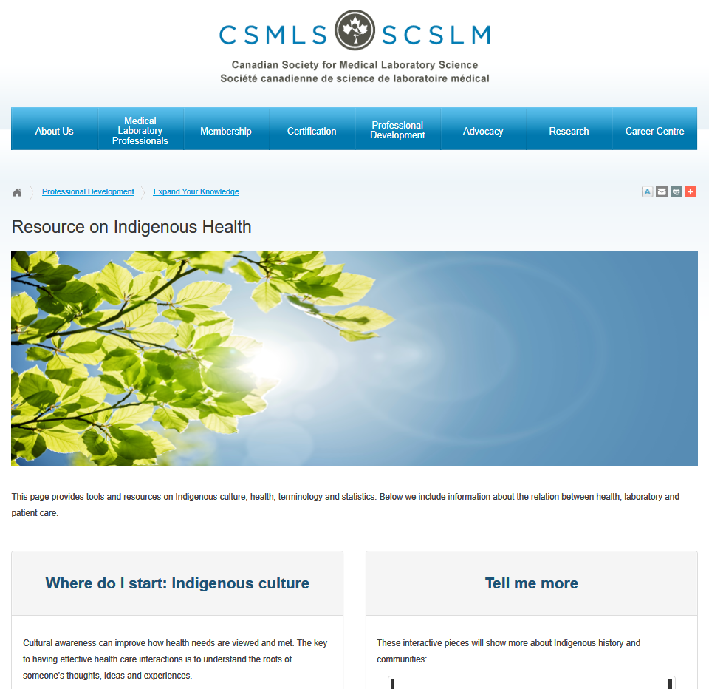

Slide 29
Questions?

