Slide 1
LEADING WITH INFLUENCE
Presented by:
Audie McCarthy
President & CEO
Mohawk College Enterprise

Slide 2
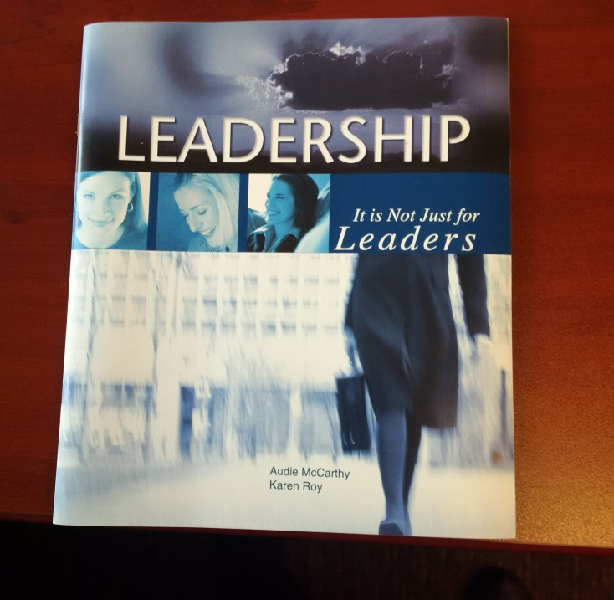
FAMOUS AUTHORS
Image source: https://images.google.com

Slide 3
LEADERSHIP QUOTES
“Never doubt that a small group of thoughtful committed citizens can change the world. Indeed, it is the only thing that ever has.”
- Margaret Mead, cultural anthropologist
“If your actions create a legacy that inspires others to dream more, learn more, do more and become more, then, you are an excellent leader.”
- Dolly Parton, singer-songwriter

Slide 4
LEADING WITH INFLUENCE
More profound than leading by your positional power alone
About a person who influenced you…
Who was it?
What did they influence you to do?
What was it about them that persuaded you to do it?
Image source: https://images.google.com

Slide 5
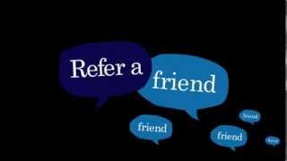
CRITICAL ATTRIBUTES
Confidence
Competence
Trustworthiness
Strong communicator
Emotional intelligence
Image source: https://images.google.com

Slide 6
CRITICAL ATTRIBUTES
Confidence
Feeling certain about your abilities
Presenting yourself to others positively
Communicating with respect, professionalism and honesty
Taking responsibility
Showing you trust others by passing on required information, techniques, skills
Involving others in decisions – be part of the team and encourage others to do the same

Slide 7
CRITICAL ATTRIBUTES
Competence
Applying skills and knowledge to a situation
Acting effectively, doing something well
Putting specific qualifications to work

Slide 8
CRITICAL ATTRIBUTES
Trustworthiness
Telling the truth, all the time
Respecting others
Following through
Being fair in thought and action
Image source: https://images.google.com

Slide 9
CRITICAL ATTRIBUTES
Strong Communicator
Striving for consistency
Being open and transparent
Exercising different forms of communication
Repeating the message
Being clear and concise
Listening to understand
Image source: https://images.google.com

Slide 10
CRITICAL ATTRIBUTES
Emotional Intelligence
Recognizing, understanding and managing one’s own emotions
Recognizing, understanding and influencing the emotions of others
www.ihhp.com/meaning-of-emotional-intelligence

Slide 11
DISTRIBUTED LEADERSHIP
Plus.google.com
http://www.felipeleon.com/its-my-business1/
http://playerstrust.com/your-trust/career/babson-college/basic-training-its-my-business

Slide 12
DISTRIBUTED LEADERSHIP
“Every single person who works within a business, for example, owns the responsibility of showing leadership at their craft. Every single teammate is the CEO of their own small business unit called their job.”
– Robin Sharma, The Leader Who Had No Title
“Distributed leadership is a conceptual and analytical approach to understanding how the work of leadership takes place among the people and in context of a complex organization.”
- Wikipedia

Slide 13
DISTRIBUTED LEADERSHIP
Assumes leadership is basically about influence
Confidence Competence
Trustworthiness
Strong communications
Emotional intelligence

Slide 14
DISTRIBUTED LEADERSHIP
Change can be driven from the front-line! Employees at Southwest Airlines took the lead in finding new ways to reduce turnaround times.
Image source: https://images.google.com

Slide 15
DISTRIBUTED LEADERSHIP
Benefits
Generates more ideas and opportunities
Builds capacity
Leadership by expertise rather than leadership by role or years of experience
Increases employee motivation and loyalty
Increases efficiencies and profits

Slide 16
DISTRIBUTED LEADERSHIP
Commitment from the top
Employees willing to take responsibility for decision making and for the results of their decision making
Trust up and down and across organizations
A common vision and guiding principles
An open and transparent organization

Slide 17
GO FORWARD
BE AN INFLUENCER
AND LEAD!
Thank you for listening!

Slide 18
Thank you for your participation

